Slide 1
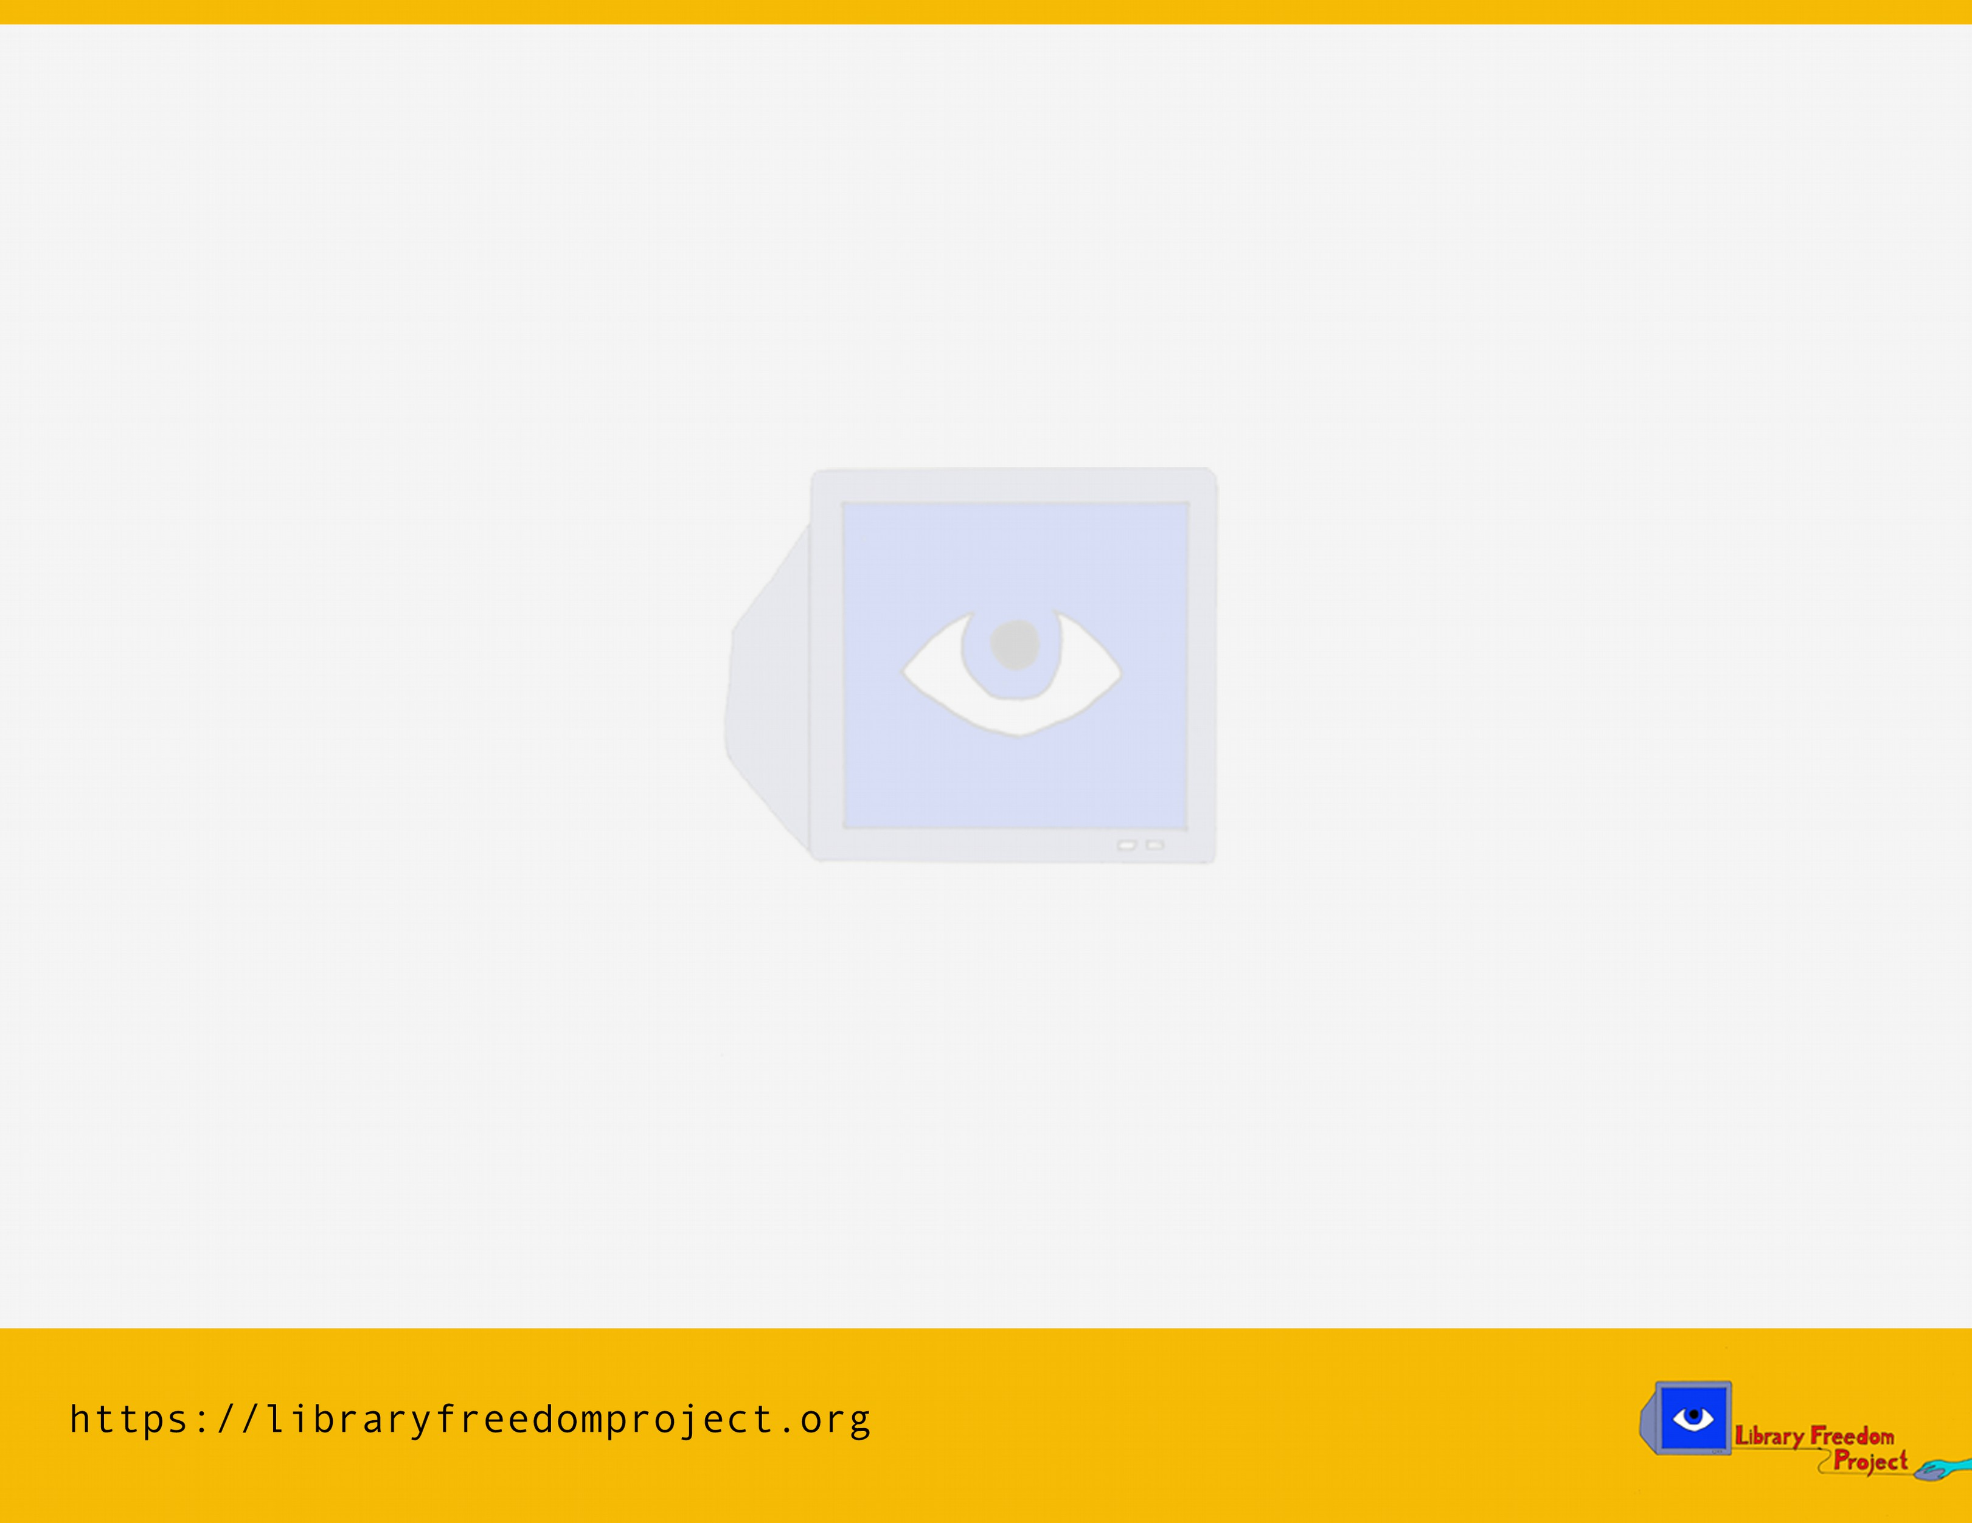
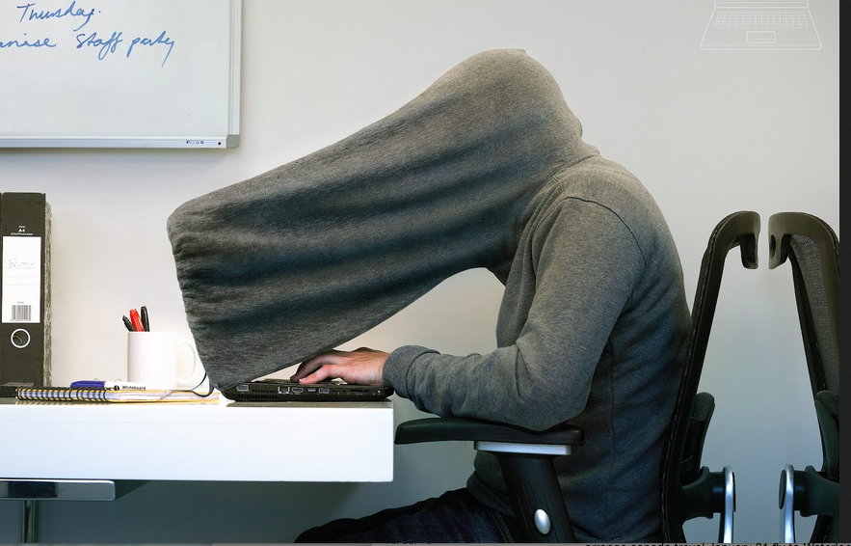
PRIVACY!

Slide 2

WRITE THIS STUFF DOWN
@flexlibris
@libraryfreedom
alison@libraryfreedomproject.org
https://libraryfreedomproject.org/teenprivacyguide/

Slide 3

KNOW YOUR THREATS

Slide 4

school administration
teachers
parents
police
other students
criminal hackers
proprietary software
mobile probs
open wifi probs
data collection
bad security

Slide 5
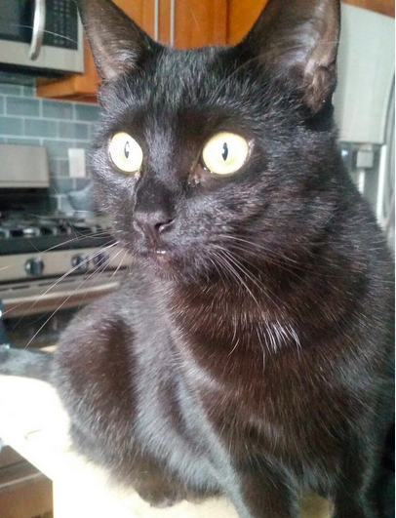
SCHOOL SURVEILLANCE
keylogging
webcam monitoring
traffic analysis
search tracking and filtering
data mining
ACLUm report
EFF report
surveillance cat is reading ur texts

Slide 6

DITCH BAD TECH

Slide 7

proprietary software
mobile probs
open wifi probs
data collection
bad security
bad browsers
bad messengers
  -EFF secure messenger scorecard (and limitations of this survey)
bad social media
  -threats from Facebook, Instagram, etc
torrent malware
other malware

Slide 8

USE GOOD TECH

Slide 9

free and open source software
trust
updates
strong encryption
data minimization
auditing

Slide 10
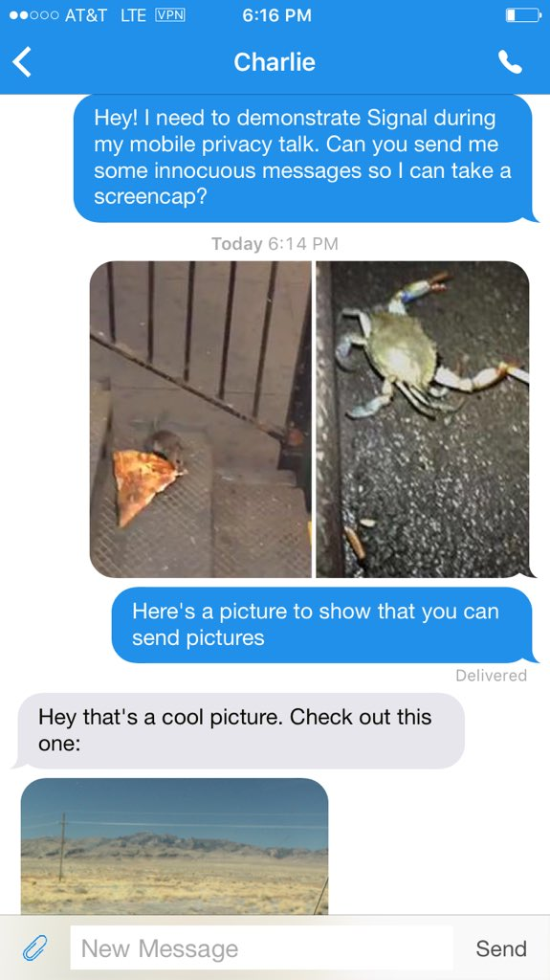
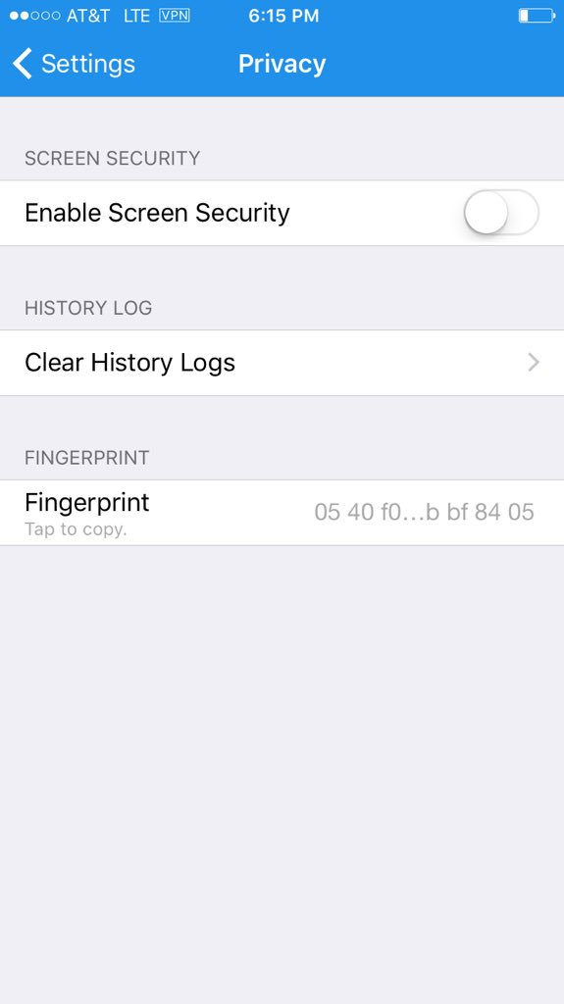
Safer calls and texts:
Signal (for iOS or Android)

Slide 11


What is Tor?
How does it protect you?
What doesn't it do?
How is it different for mobile?
Tor Browser for desktops or flash drives
Onion browser for iOS (not official)
Orbot: proxy with Tor for Android
Orweb: Tor Browser for Android

Slide 12
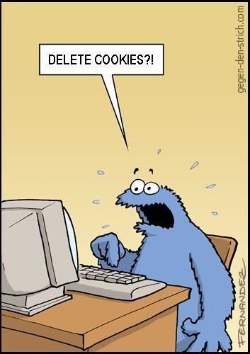
Blocking invisible trackers
cookies, scripts, other trackers
NoScript
(installed in Tor Browser)
Privacy Badger
uBlock Origin

Slide 13

Passwords and password managers

Slide 14
complexity and randomness
xkcd passphrases with Diceware
Yubikeys
password managers
  -KeePassX
  -KeePass
  -1Password
mobile passwords

Slide 15

Disk encryption
OSX: Filevault
Windows: Device Encryption and Bitlocker
Linux: dm-crypt and LUKS
Android: depends on phone
iOS: built in to latest versions

Slide 16

Safer chats with Ricochet
Ricochet is anonymous and ephemeral chat client
Open Tor Browser
Then open Ricochet
Share your Ricochet ID:
  ricochet:rs7ce36jsj24ogfw
Send a contact request
Chat safely

Slide 17


GIVE ME EXTRA CREDIT
ACLU: know your rights and more
EFF
Tor Project
CryptoParties
LFP resources
reading list

Slide 18


alison@libraryfreedomproject.org
@libraryfreedom
libraryfreedomproject.org/feedback
CC-BY-SA 4.0 International
www.creativecommons.org

